Slide 1
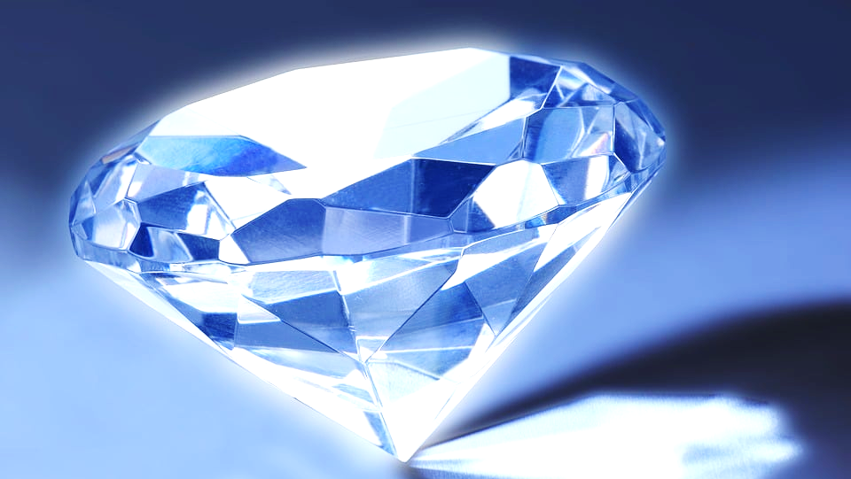
Diamond Market Analysis Gem Value Analytics Benedict Ouma (3rd June 2025)

Slide 2


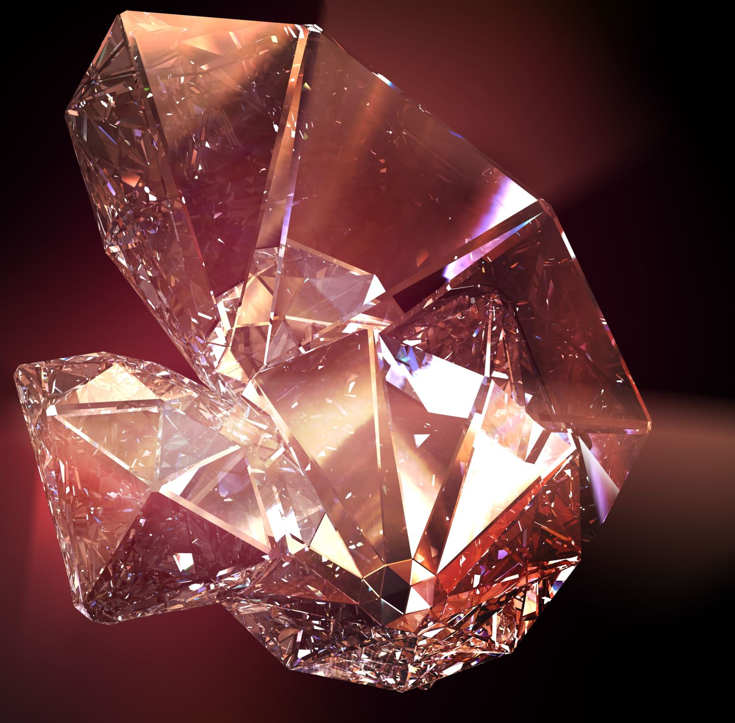
Background of the analysis The diamond industry is a multibillion-dollar global market driven by quality, rarity, and consumer perception. Accurately pricing diamonds is essential for profitability, transparency, and competitiveness. Industry relevance With increasing online jewelry sales and customer awareness, there is a growing need for data-driven pricing. Understanding how features like carat, cut, color, and clarity influence price can help businesses price more competitively and strategically. Objective of the analysis To explore key drivers of diamond prices to detect patterns, outliers, and trends in a dataset of over 50,000 diamonds to deliver actionable insights using Python, pandas, and seaborn to provide data visualizations and a business-friendly interpretation for decision-making

Slide 3
PROBLEM STATEMENT Business context The diamond industry is highly competitive, and accurate pricing is critical for profitability. Jewelers and retailers need to understand what factors drive diamond prices to optimize inventory, marketing, and sales strategies.
Problem definition
Goal of analysis
What are we predicting?
Gem Value Analytics seeks to uncover the key physical and grading attributes that influence the price of diamonds to support:
Price prediction
Market segmentation
Inventory valuation strategies
To analyze a dataset of over 50,000 diamonds to:
Identify major pricing drivers
Detect outliers and skewed features
Understand the relationship between physical attributes and price
Provide actionable insights using data visualization
We aim to predict and explain the price of diamonds based on features such as:
Carat
Cut
Color
Clarity
Physical dimensions (x, y, z)
Table and depth proportions
Customer & Market Need
Why do prices vary?
Analyze Features (Carat, Cut, Colo
Detect Trends & Patterns
Predict Price Drivers
Business Insight & Decision Support

Slide 4

Summary Statistics
Variable | Description | Data Type
carat | Weight of the diamond (in carats) | float64
cut | Quality of the cut (Fair, Good, Very Good, Premium, Ideal) | category / object
color | Diamond color grading from J (worst) to D (best) | category / object
clarity | Clarity grading (I1 worst to IF best) | category / object
depth | Total depth % = z / mean(x, y) | float64
table | Width of top of diamond relative to widest point | float64
price | Price in US dollars ($326–$18,823) | int64
x | Length in mm | float64
y | Width in mm | float64
z | Depth in mm | float64
Attribute | Description | Data Type
DATA DESCRIPTION
Data Snapshot
Number of Records - 53,940
Missing Values - 0
Duplicates - 146
Data Types - A mix of numerical (carat, price, dimensions) and categorical (cut, color, clarity)

Slide 5
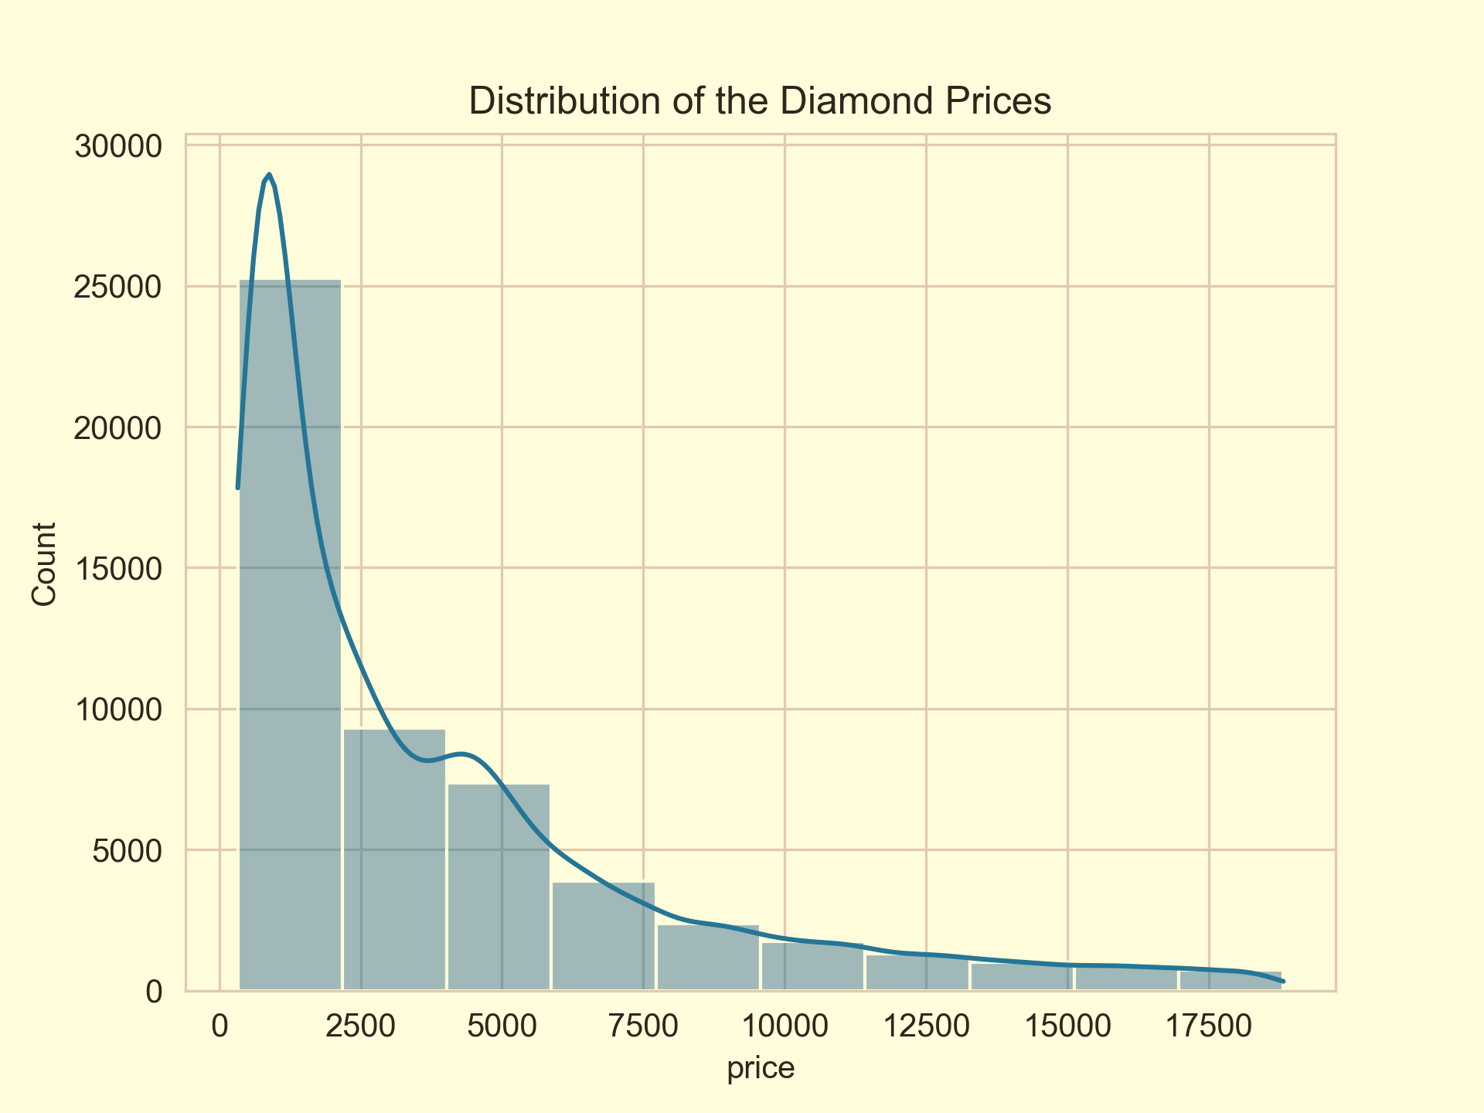
EXPLORATORY DATA ANALYSIS VISUALIZATION
Right-Skewed Distribution (Positively Skewed)
Most diamonds are low-priced, clustered towards the left (under 2,500 USD).
A few diamonds are very expensive, causing a long tail on the right.
The majority of Diamonds Are Affordable
Over 25,000 diamonds are priced below 2,500 USD.
The count drops sharply as the price increases.
Rare Expensive Diamonds
Diamonds priced above 10,000 USD are relatively rare.
The diamond market (in this dataset) is dominated by lower-priced diamonds.

Slide 6
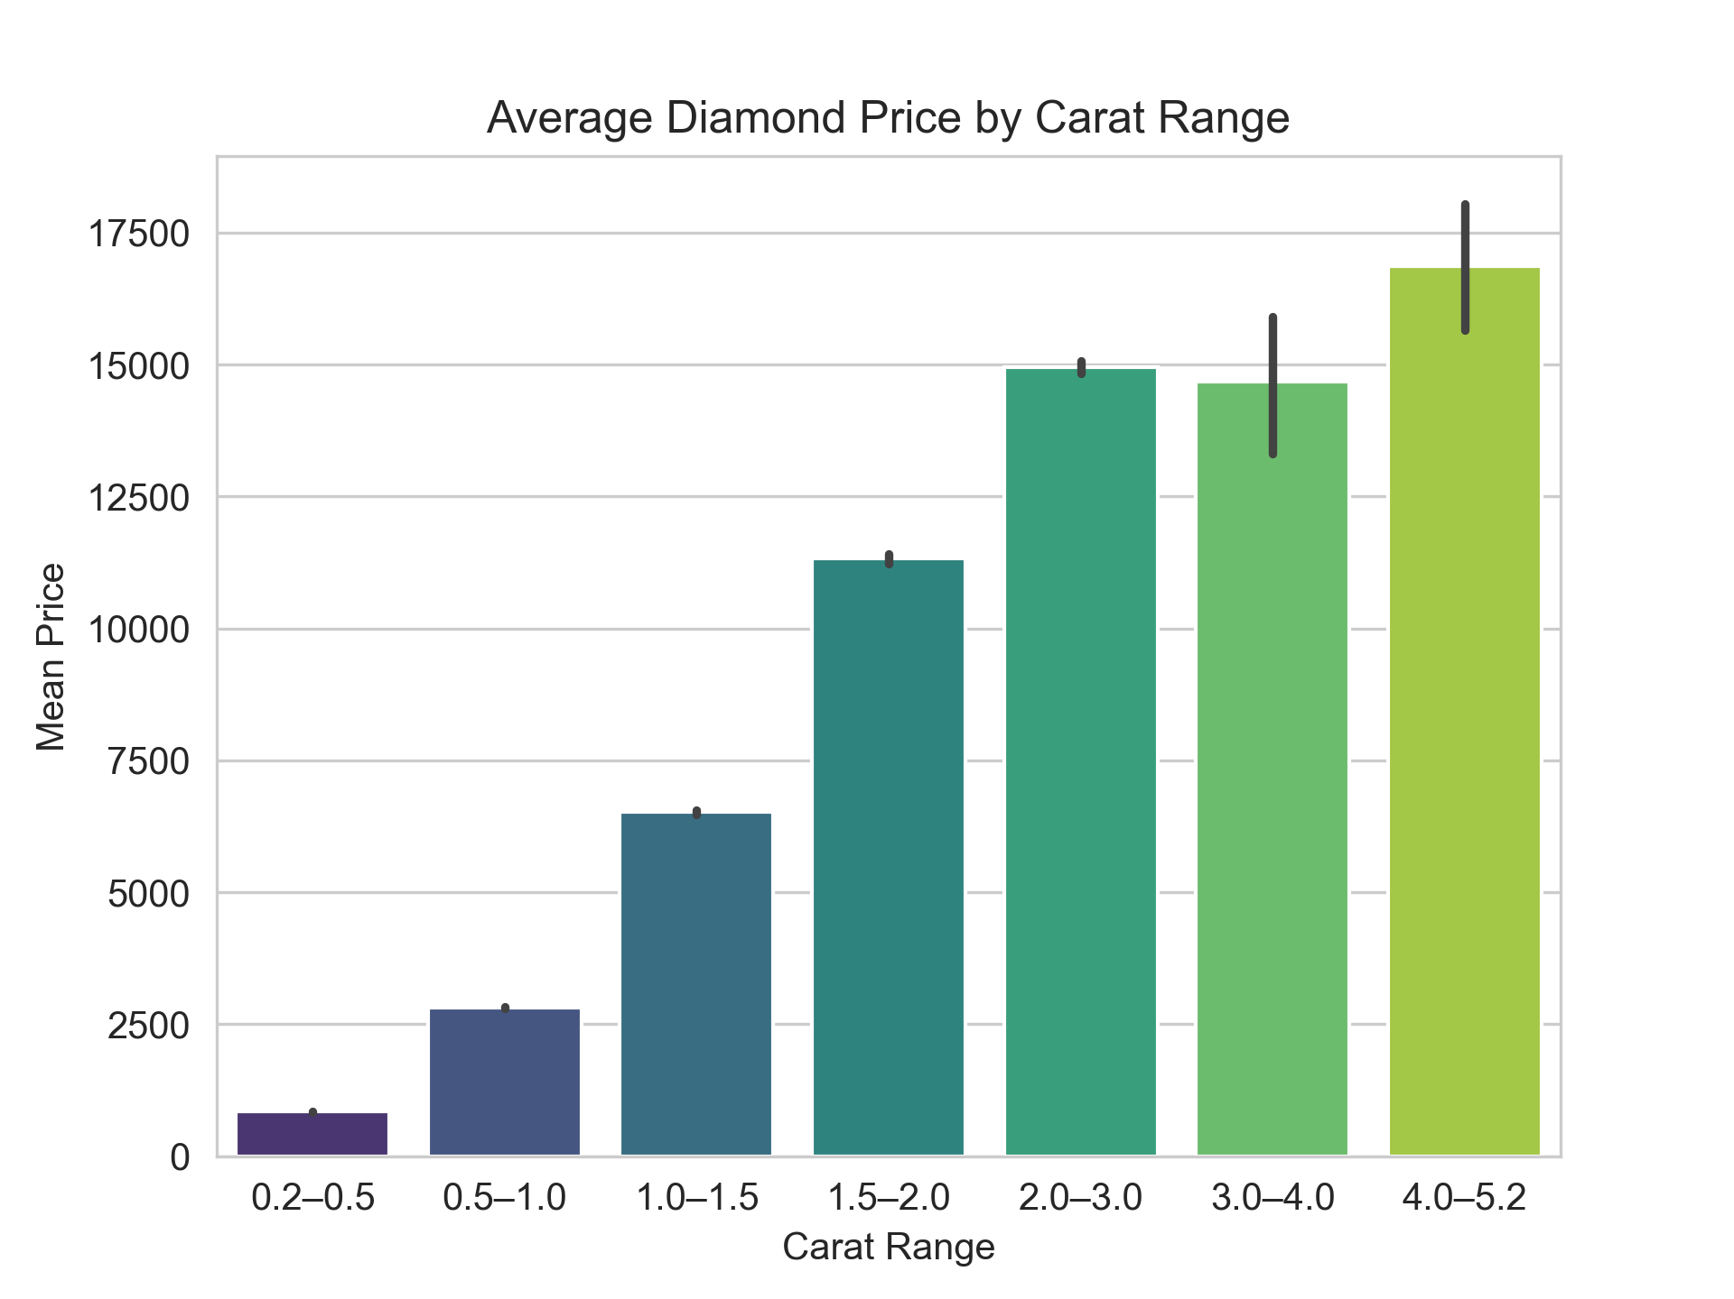
The analysis reveals a strong positive relationship between carat weight and diamond price, with a noticeable upward trend indicating that as carat increases, the average price rises significantly. This relationship is non-linear, with price surging more steeply beyond the 2.0 to 3.0 carat range - likely driven by the rarity and desirability of larger diamonds. The most dramatic price jumps occur between the 3.0 to 4.0 and 4.0 to 5.2 carat ranges, suggesting an exponential pricing pattern in the upper carat tiers. Overall, the findings highlight that carat is a major driver of diamond pricing, especially at higher weight levels where prestige and scarcity amplify value.

Slide 7
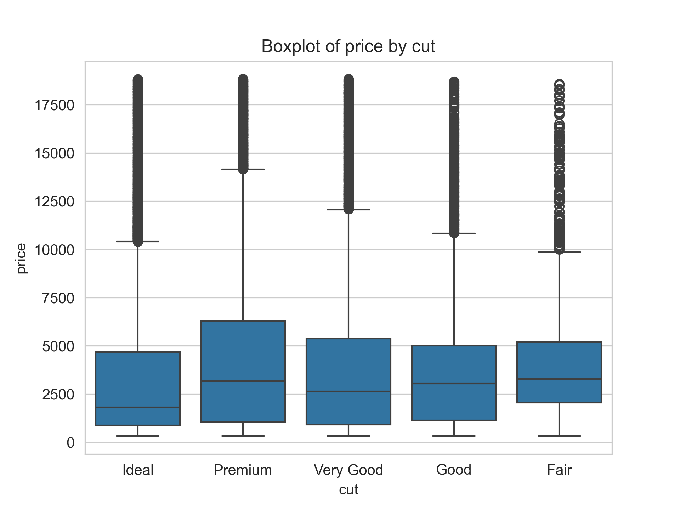
The analysis shows that while the ideal cut is the most common and generally associated with high quality, it tends to have a lower price range compared to other cuts. Premium and very good cuts exhibit slightly higher price variability, suggesting other influencing factors are at play. High-priced outliers are present across all cut categories, revealing that cut quality does not solely determine diamond price. Notably, even fair-cut diamonds can command higher prices than ideal cuts when combined with other premium attributes such as greater carat weight, better color, or higher clarity. This underscores that pricing is influenced by a combination of features, not just cut quality.

Slide 8
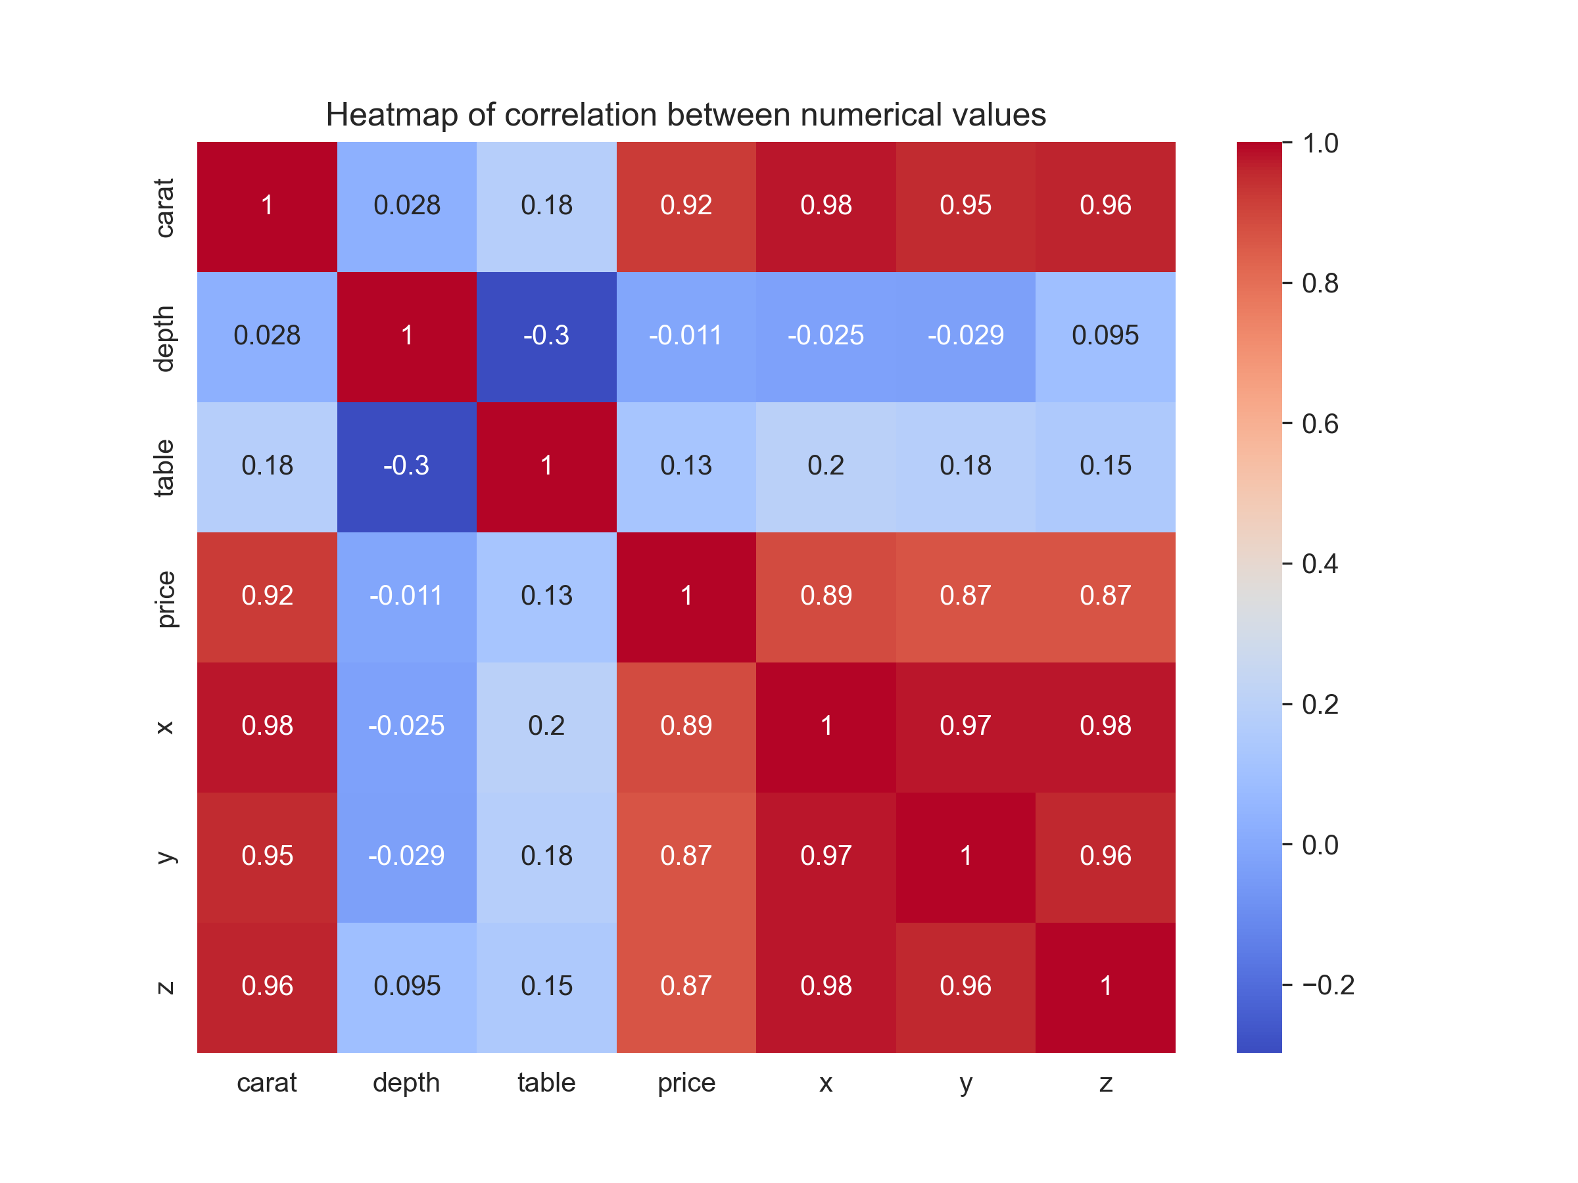
The heatmap reveals that the most influential factors affecting diamond price are carat and the physical dimensions (x, y, and z), all showing strong positive correlations. This indicates that size and weight are the primary drivers of diamond pricing, with carat being the most predictive single feature. Conversely, depth and table exhibit very weak or even negative correlations with price and carat, implying they do not significantly impact a diamond's value on their own. These findings suggest that any pricing model should prioritize carat and dimensions, while features like depth and table may have a secondary or negligible influence on pricing.

Slide 9
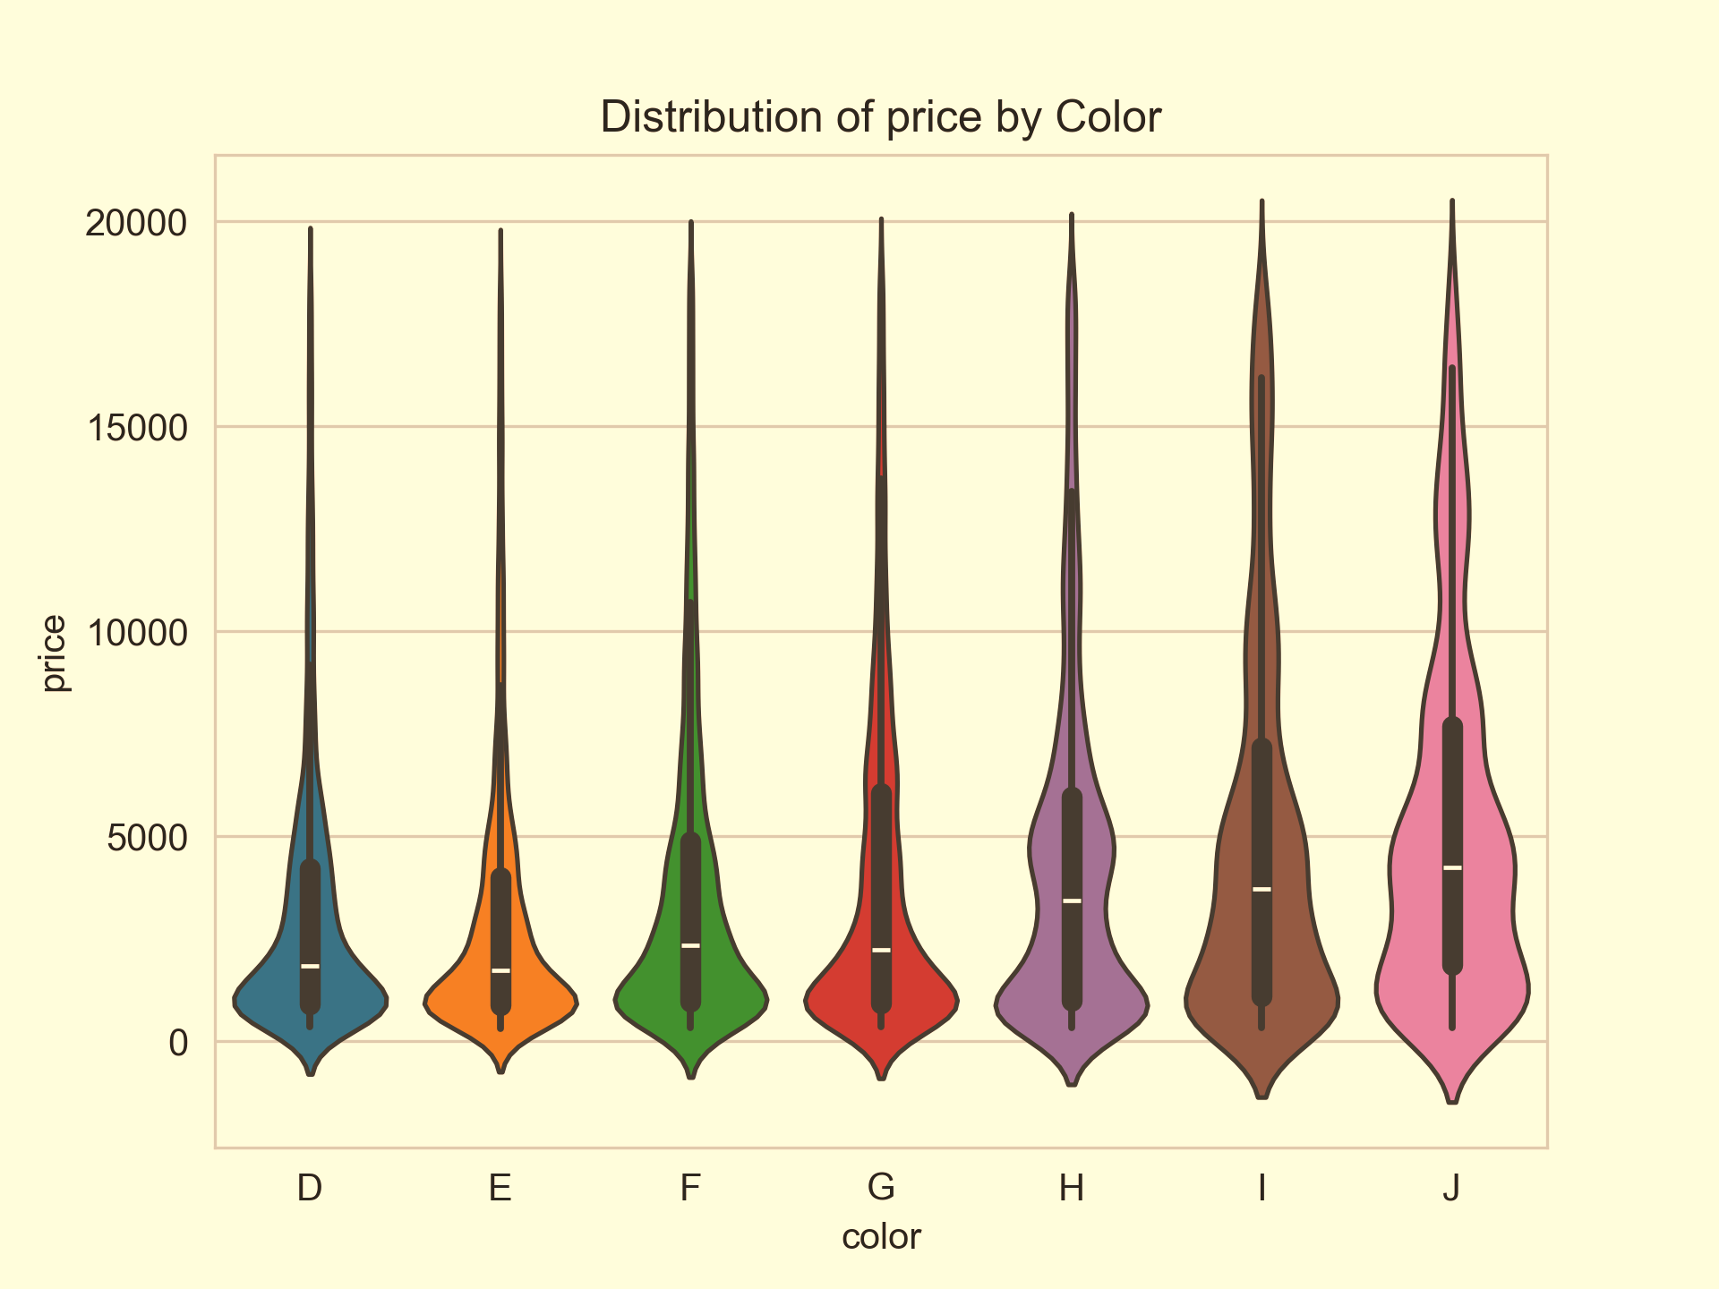
The violin plot reveals that while diamond prices overlap across color grades D to J, there are distinct density distributions that highlight how color impacts price. Most diamonds, regardless of color, are concentrated in the lower price ranges (below Ksh 13,000–20,000), with the density narrowing sharply at higher prices, indicating that expensive diamonds are relatively rare. Interestingly, high-quality colors like D are less common and show less density overall, suggesting they are either less available or less frequently purchased. On the other hand, lower-quality colors like J dominate the lower price ranges, reflecting their popularity among cost-conscious buyers. This suggests that the diamond market leans heavily toward affordability, with fewer transactions involving high-end, colorless stones.

Slide 10
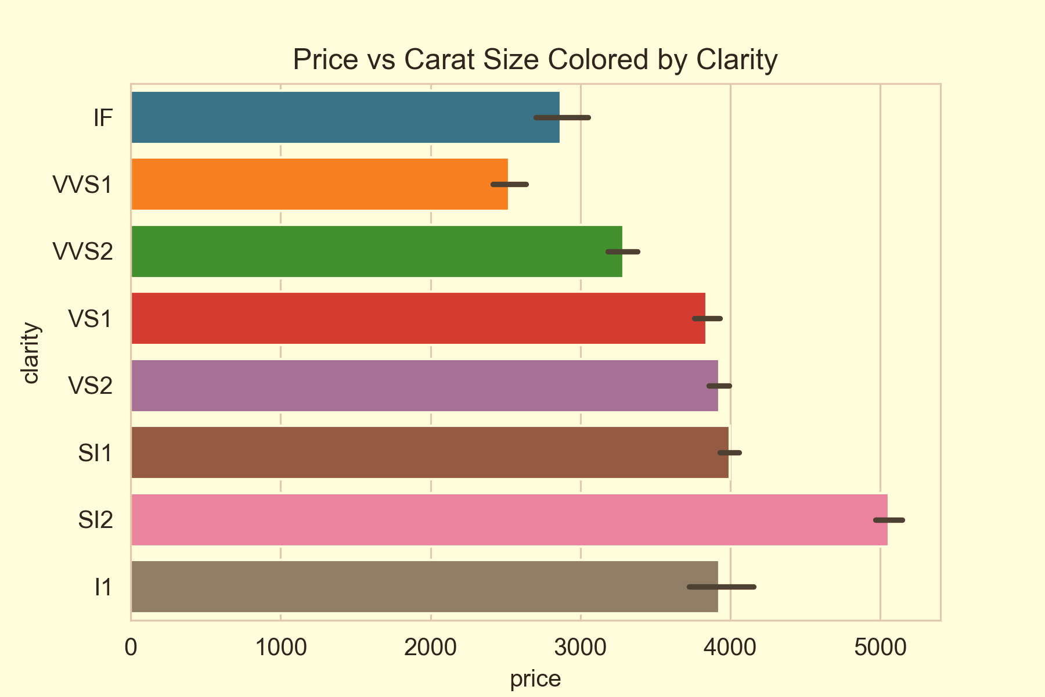
Although clarity levels are ranked from most to least clear, the pricing trend doesn't align perfectly with this order. Notably, diamonds with lower clarity grades like SI2 display the highest average prices. This suggests that clarity is not the sole factor influencing diamond pricing - other attributes such as carat weight, cut quality, and color play a crucial role in determining overall value.

Slide 11
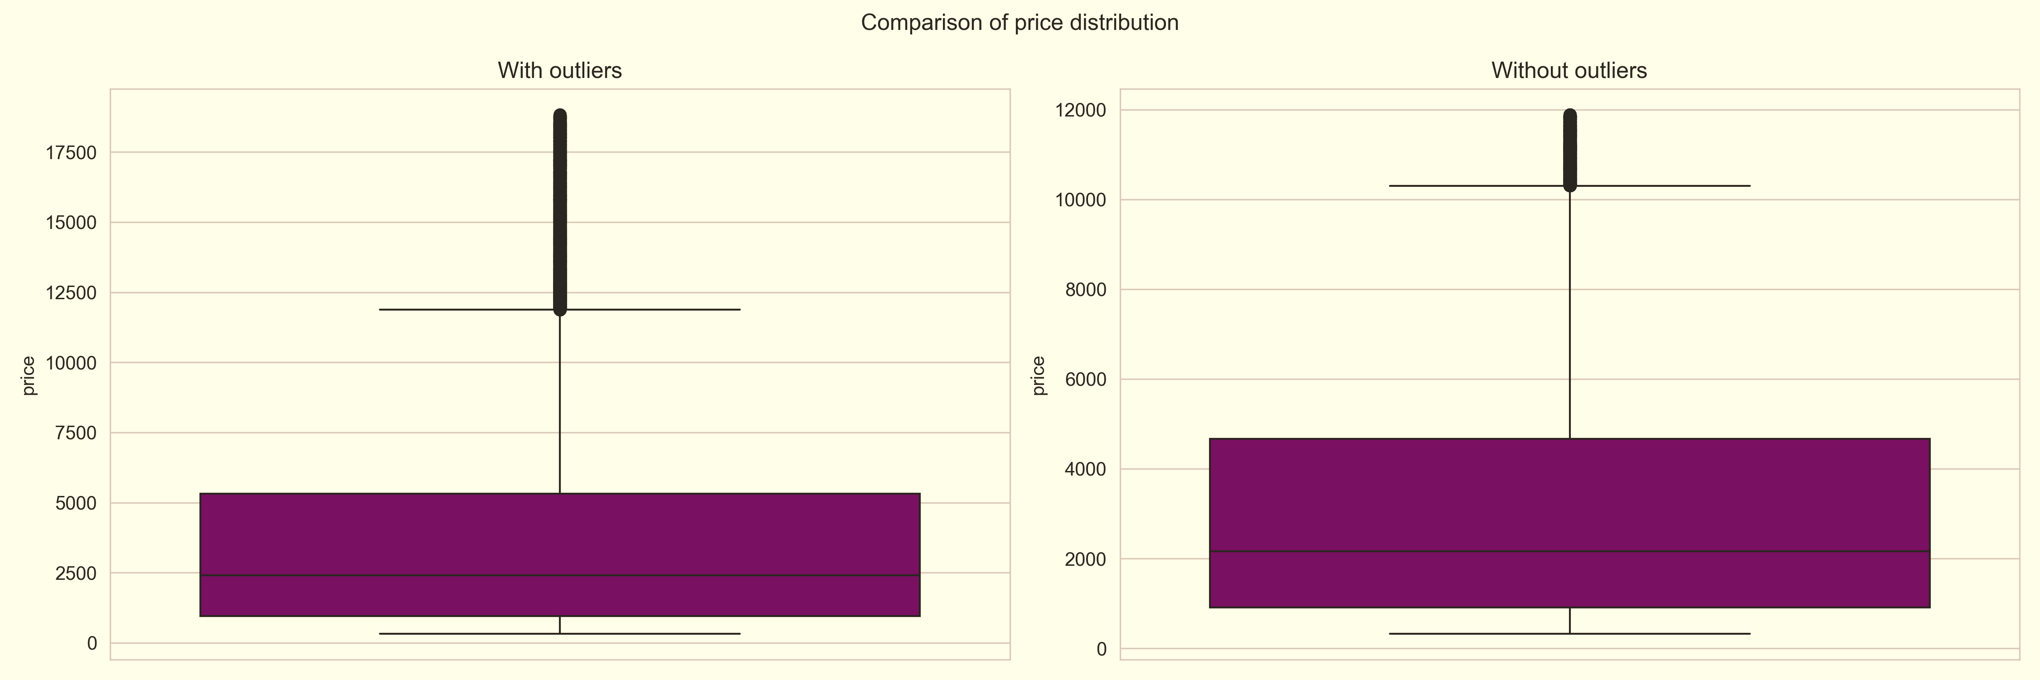
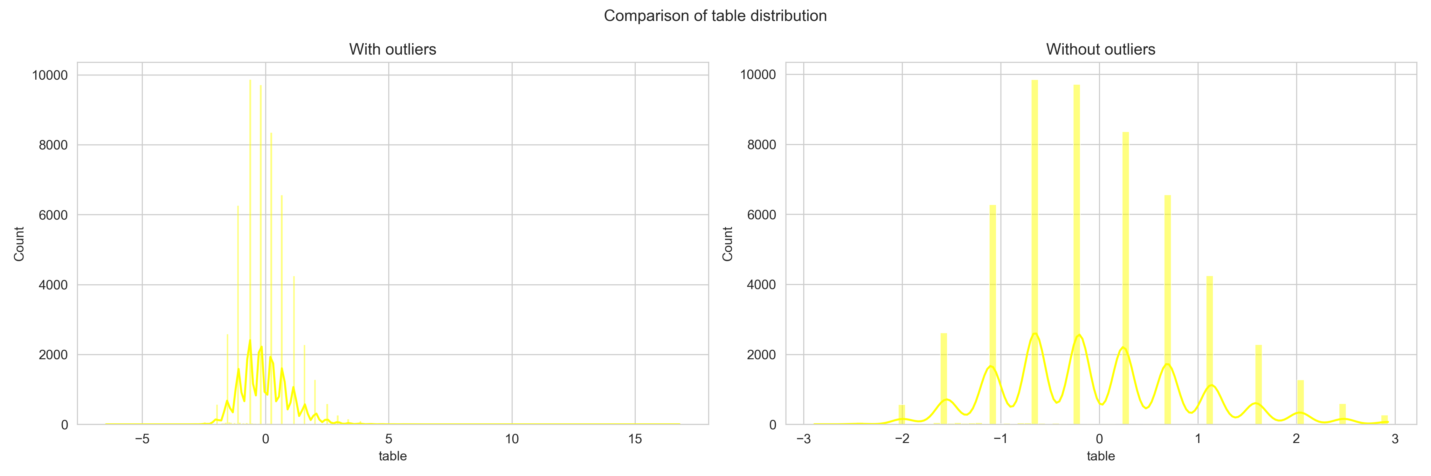
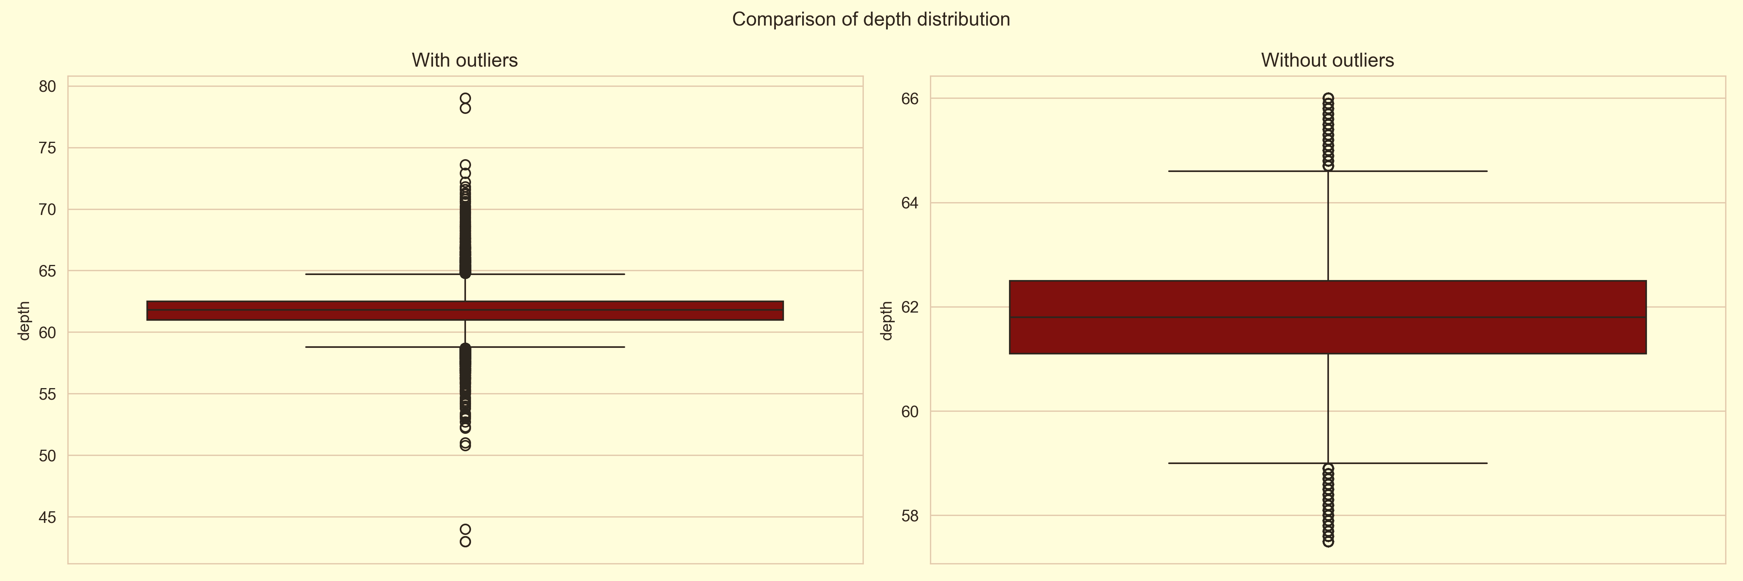
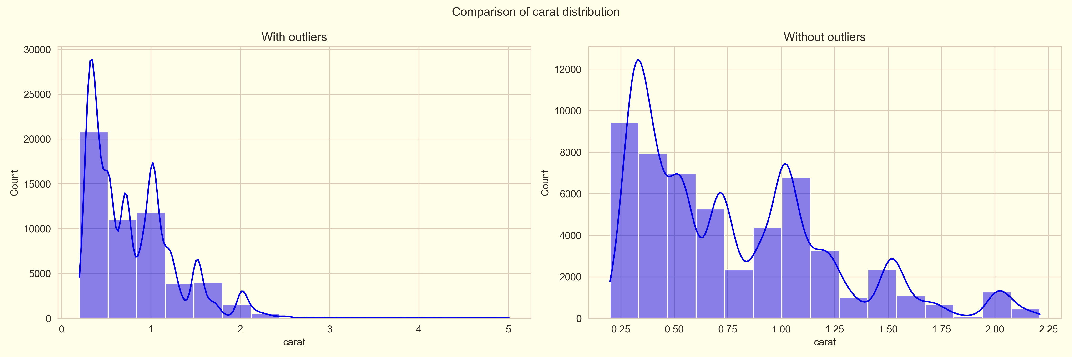
Comparison of price, table, depth, and carat distribution with and without outliers

Slide 12
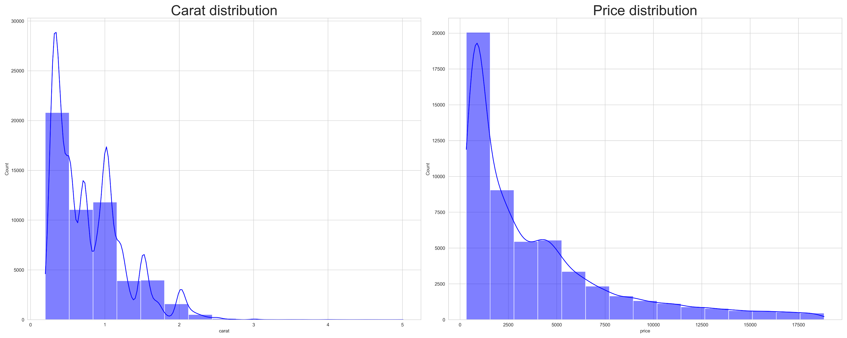
The side-by-side distribution plots of carat and price reveal that both variables are positively skewed. Most diamonds are small in size and relatively affordable, clustering towards the lower end of both distributions. The long right tails in both plots indicate that high-carat and high-priced diamonds are rare outliers in the dataset. This skewness suggests that the data is not normally distributed, which is important when selecting appropriate statistical or machine learning models, as it may require log transformations or robust modeling techniques to handle the imbalance effectively.

Slide 13
METHODOLOGY
The diamonds dataset was sourced from the seaborn library. Initial data cleaning involved removing duplicates and confirming absence of missing values. Univariate and bivariate analyses were conducted to explore the distribution of variables such as carat, cut, and price. Boxplots, histograms, and correlation matrices were utilized to reveal the relationships between the physical characteristics of diamonds and their prices. These insights laid the groundwork for future statistical modeling and hypothesis testing.

Slide 14
Results & Insights
KEY FINDINGS:
KEY INSIGHTS:
The most strongly correlated factors with diamond price are:
Carat weight
Physical dimensions (x, y, z)
This shows that size and weight are major determinants of price.
Depth and table have weak or no significant correlation with price.
Cut quality alone does not strongly influence price.
Clarity and color also have a significant impact on diamond value.
Diamonds with smaller carat weight are more commonly available.
The most common diamond prices are around those with lesser price
Diamonds with high carat are very expensive and less frequent in the dataset whereas those with less carat are the most available ones
Physical size, that is carat and dimensions, are the main drivers of price, not just cut or color.
Most diamonds have a carat range between 0.2 to 1.0, making them the most common size.
The most frequent price for diamonds is around 2,500 USD.
There is a strong positive relationship between carat size and price - bigger diamonds cost more.
Physical dimensions (x, y, z) also show a strong correlation with price.
Features like depth and table have little or no effect on price.

Slide 15
Recommendations
The stakeholders:
ACTIONABLE INSIGHTS:
Optimization of pricing strategy should revolve around carat and clarity.
Should find it more efficient to use size-based segmentation when marketing diamonds.
Prioritize carat size in pricing and marketing. Carat and size are the strongest predictors of price - focus on these when setting prices and advertising diamonds2.
Stock more diamonds in the 0.2 – 1.0 carat range. This range is most common and affordable (2,500 USD), so increasing inventory here will likely meet higher customer demand.
Should not overemphasize cut alone since cut does not significantly affect price on its own, focus instead on clarity, color, and carat when determining value.
Carat weight is the strongest driver of price. Focus on promoting diamonds by their carat size to align with pricing expectations.
Diamonds in the 0.2 – 1.0 carat range dominate the market. Prioritize stocking and targeting marketing for this most in-demand segment.
Most diamonds are priced around $2,500 USD. Price new inventory competitively within this range to attract more buyers.
Depth and table have minimal impact on price. Don’t overemphasize these in marketing or valuation - they are not key value indicators.
Clarity and color significantly influence value. Use high clarity and color grades to justify premium pricing.

Slide 16
Conclusion
PROBLEM RECAP:
The objective was to identify the key factors influencing diamond prices to enable smarter pricing, inventory management, and marketing strategies. This was achieved through exploratory data analysis (EDA) on the seaborn diamonds' dataset.
APPROACH TAKEN:
Analyzed over 50,000 diamonds using python and seaborn.
Cleaned the dataset by removing duplicates and checking for missing data.
Conducted univariate and bivariate analyses employing visualizations such as histograms, boxplots, and correlation matrices.
Explored relationships between features like carat, cut, clarity, dimensions (x, y, z), depth, table, and price.
KEY FINDINGS:
Primary predictors: carat size and physical dimensions (x, y, z) are the strongest indicators of diamond price.
Limited influence: depth and table measurements show little to no significant effect on price.
Other factors: while cut influences value, it alone does not determine price; clarity and color also play substantial roles.
Distribution patterns: most diamonds are within the 0.2 - 1.0 carat range, with prices averaging around 2,500 USD.
Size as a driver: overall, size - measured by carat weight and volume - is the most significant driver of price, with the physical dimensions also contributing.
This analysis provides valuable insights into which features most significantly impact diamond valuation, aiding in more informed decision-making.

Slide 17

Thank you
This analysis highlights the importance of data-driven decision making in the diamond industry. Stakeholders can use these insights to better price, market, and stock their products, focusing on features that truly influence value. Future work can involve predictive modeling to forecast prices or apply machine learning for automated valuation.

